Slide 1
Variables in PHP
Bryan Duggan

Slide 2
Variables in PHP
Variables in PHP are denoted by a dollar sign followed by the name of the variable.
A variable name is case-sensitive.
A valid variable name starts with a letter or underscore, followed by any number of letters, numbers, or underscores.

Slide 3
Example Usage of Variables
<html>
<head>
<title>Greetings</title>
</head>
<body>
<h1>Greetings</h1>
<p>
<?php $person = "Tom";
$Person = "Dick";
echo "Hello $person and $Person";
?>
</p>
</body>
</html>

Slide 4
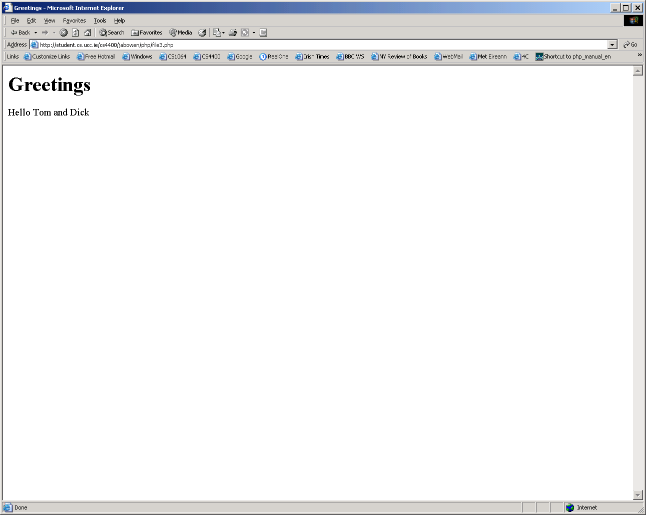

Slide 5
Data Types in PHP
PHP supports eight primitive data types
There are four scalar types
  boolean
  integer
  floating-point number
  string
There are two structured types
  array
  object
There are two special data types
  resource
  NULL
The programmer does not specify the type of a variable
  a variable’s type is determined from the context of its usage

Slide 6
Booleans
The boolean data type admits two values
  true (case-insensitive)
  false (case-insensitive)
Example usage
  $itIsRainingToday = true;
  $thePrinterIsBusy = True;
  $theQueueIsEmpty = FALSE;

Slide 7
Integers
Integers can be specified in decimal, hexadecimal or octal notation, optionally preceded by a sign
  In octal notation, the number must have a leading 0
  In hexadecimal notation, the number must have a leading 0x.
Examples
    $a = 1234; # decimal number
    $a = -123; # a negative number
    $a = 0123; # octal number (equivalent to 83 decimal)
    $a = 0x1B; # hexadecimal number (equivalent to 27 decimal)
The maximum size of an integer is platform-dependent, but usually it’s 32 bits signed – about 2,000,000,000
PHP does not support unsigned integers.

Slide 8
Floating Point Numbers
These can be specified using any of these forms:
      $a = 1.234;
      $a = 1.2e3;
      $a = 7E-10;
The maximum size of a float is platform-dependent, although most support a maximum of about 1.8e308 with a precision of roughly 14 decimal digits

Slide 9
Strings
A string literal can be specified in three different ways:
      single quoted
      double quoted
      heredoc syntax

Slide 10
Single-quoted Strings
In single-quoted strings, single-quotes and backslashes must be escaped with a preceding backslash
Example usage
echo 'this is a simple string';
echo 'You can embed newlines in strings,
just like this.';
echo ‘Douglas MacArthur said "I\'ll be back” when leaving the Phillipines';
echo 'Are you sure you want to delete C:\\*.*?';

Slide 11
Double-quoted Strings
In double-quoted strings,
  variables are interpreted to their values, and
  various characters can be escaped
    \n linefeed
    \r carriage return
    \t horizontal tab
    \\ backslash
    \$ dollar sign
    \” double quote
    \[0-7]{1,3} a character in octal notation
    \x[0-9A-Fa-f]{1,2} a character in hexadecimal notation

Slide 12
Heredoc Strings
Heredoc strings are like double-quoted strings without the double quotes
A heredoc string is delimited as follows
  The string is preceded by <<< followed by a label
  The string followed by a 2nd occurrence of the same label
Example usage
$str = <<<EOD
Example of string
spanning multiple lines
using heredoc syntax.
EOD;

Slide 13
Arrays
An array in PHP is a structure which maps keys to values
The keys can specified explicitly or they can be omitted
If keys are omited, integers starting with 0 are keys
The value mapped to a key can, itself, be an array, so we can have nested arrays

Slide 14
Specifying an array
A special function is used to specify arrays
  array( )
Format of Usage
array( [key =>] value, … )
A key is either a string or a non-negative integer
A value can be anything

Slide 15
Specifying an array (contd.)
Format of array specification
    array( [key =>] value, ... )
Here is a hash array:
$mothers =
array (“tom"=>“mary", “mick"=>“ann", “bill"=>“orla");
Implicit indices are integers, starting at 0
  Here is an ordinary array (indexed by integers, starting at 0):
      $places = array (“Cork”, “Dublin”, “Galway”);

Slide 16
Specifying an array (contd.)
If an explicit integer index is followed by implicit indices, they follow on from the highest previous index
  Here is an array indexed by integers 1, 2, 3
    $places = array (1 => “Cork”, “Dublin”, “Galway”);
  Here is an array indexed by integers 1, 5, 6
    $places = array (5=> “Cork”, 1 => “Dublin”, “Galway”);

Slide 17
Specifying an array (contd.)
A two-dimensional hash array
$parents =
array ( “tom” => array (“father” => “bill”, “mother”=> “mary”),
“dave” => array(“father” => “tom”, “mother” => orla”)
);
A two-dimensional ordinary array
$heights =
array ( array (10,20),
array(100,200)
);

Slide 18
Array Example 1
<html>
<head><title>Array Demo</title></head>
<body>
<h1>Array Demo</h1>
<p>
<?php
$capital = array ('France'=>'Paris','Ireland'=>'Dublin');
echo 'The capital of Ireland is ';
echo $capital['Ireland'];
?>
</p>
</body>
</html>

Slide 19
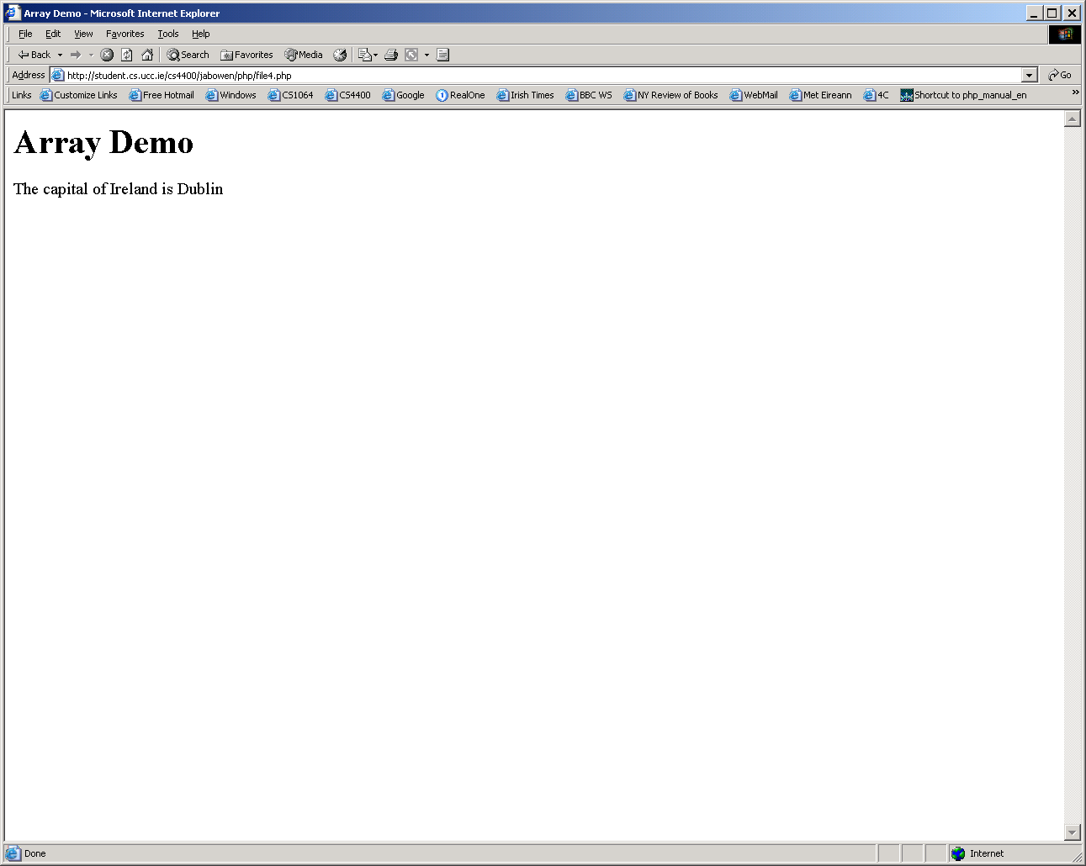

Slide 20
Array Example 2
<html>
<head><title>Array Demo</title></head>
<body>
<h1>Array Demo</h1>
<p>
<?php
$capital = array ('France'=>'Paris', ‘Ireland'=>'Dublin');
echo "The various capitals are\n<ul>";
foreach ($capital as $city) { echo "<li>$city</li>"; };
echo "</ul>"
?>
</p>
</body>
</html>

Slide 21
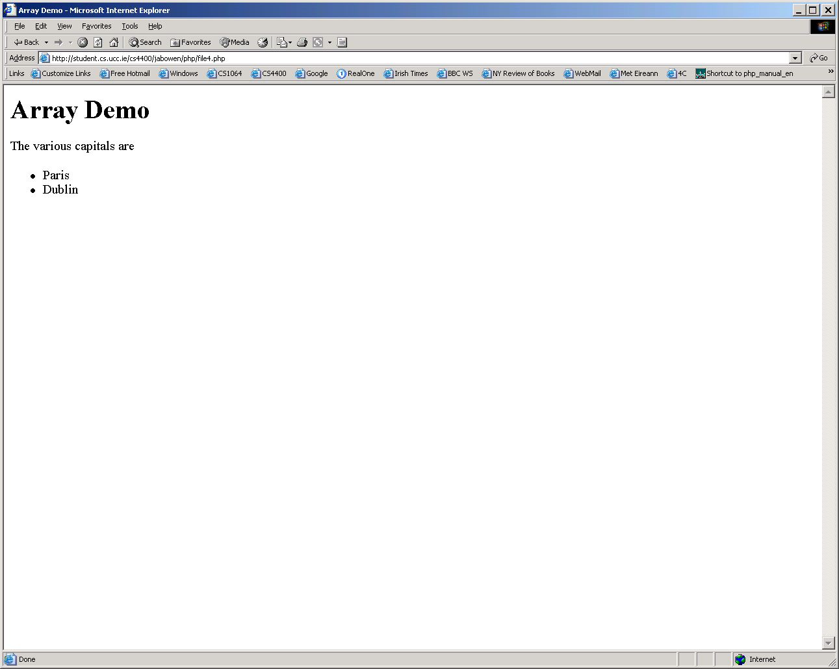

Slide 22
Array Example 3
<html>
<head><title>Array Demo</title></head>
<body>
<h1>Array Demo</h1>
<p>
<?php
$capital = array ('France'=>'Paris', 'Ireland'=>'Dublin');
echo "The various capitals are\n<ul>";
foreach ($capital as $country => $city)
{ echo "<li>The capital of $country is $city</li>"; };
echo "</ul>"
?>
</p>
</body>
</html>

Slide 23
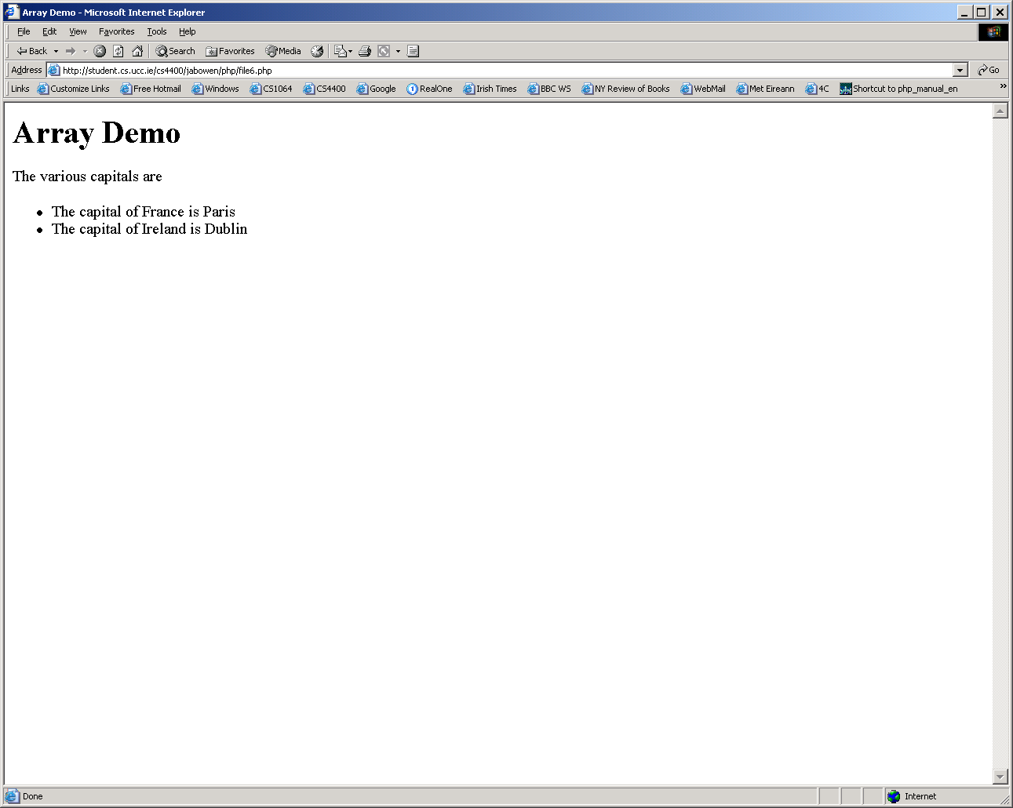

Slide 24
Array Example 4
<html>
<head>
<title>Details about Fred</title>
</head>
<body>
<h1>Details about Fred</h1>
<?php
$ages = array ("Fred" => 2, "Tom"=> 45);
$parents = array ("Fred" => array("father" => "Tom", "mother"=>"Mary"));
print "<p> Fred's age is ";
print $ages["Fred"];
print ".</p>";
print "<p>His father is ";
print $parents["Fred"]["father"];
print ".</p>";
?>
</body>
</html>

Slide 25

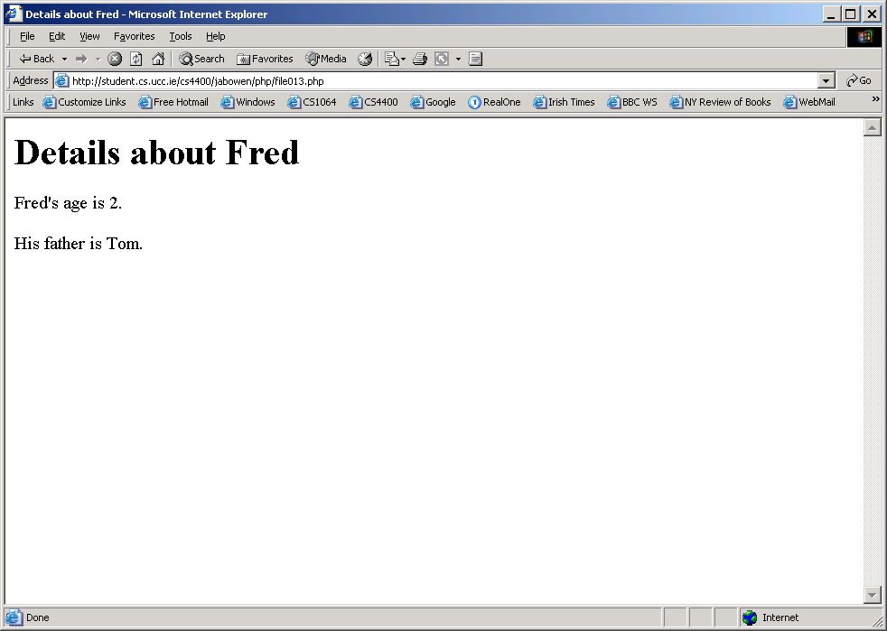

Slide 26
Array-manupulation functions
PHP provides a huge set of array-manipulation functions
array -- Create an array
array_change_key_case -- Returns an array with all string keys lowercased or uppercased
array_chunk -- Split an array into chunks
array_count_values -- Counts all the values of an array
array_diff -- Computes the difference of arrays
array_filter -- Filters elements of an array using a callback function
array_flip -- Flip all the values of an array
array_fill -- Fill an array with values
array_intersect -- Computes the intersection of arrays
array_key_exists -- Checks if the given key or index exists in the array
array_keys -- Return all the keys of an array
array_map -- Applies the callback to the elements of the given arrays
array_merge -- Merge two or more arrays
array_merge_recursive -- Merge two or more arrays recursively
array_multisort -- Sort multiple or multi-dimensional arrays
array_pad -- Pad array to the specified length with a value

Slide 27
array_pop -- Pop the element off the end of array
array_push -- Push one or more elements onto the end of array
array_rand -- Pick one or more random entries out of an array
array_reverse -- Return an array with elements in reverse order
array_reduce -- Iteratively reduce the array to a single value using a callback function
array_shift -- Shift an element off the beginning of array
array_slice -- Extract a slice of the array
array_splice -- Remove a portion of the array and replace it with something else
array_sum -- Calculate the sum of values in an array.
array_unique -- Removes duplicate values from an array
array_unshift -- Prepend one or more elements to the beginning of array
array_values -- Return all the values of an array
array_walk -- Apply a user function to every member of an array
arsort -- Sort an array in reverse order and maintain index association
asort -- Sort an array and maintain index association
compact -- Create array containing variables and their values
count -- Count elements in a variable
current -- Return the current element in an array

Slide 28
each -- Return the current key and value pair from an array and advance the array cursor
end -- Set the internal pointer of an array to its last element
extract -- Import variables into the current symbol table from an array
in_array -- Return TRUE if a value exists in an array
array_search -- Searches the array for a given value and returns the corresponding key if successful
key -- Fetch a key from an associative array
krsort -- Sort an array by key in reverse order
ksort -- Sort an array by key
list -- Assign variables as if they were an array
natsort -- Sort an array using a "natural order" algorithm
natcasesort -- Sort an array using a case insensitive "natural order" algorithm
next -- Advance the internal array pointer of an array
pos -- Get the current element from an array
prev -- Rewind the internal array pointer
range -- Create an array containing a range of elements
reset -- Set the internal pointer of an array to its first element

Slide 29
rsort -- Sort an array in reverse order
shuffle -- Shuffle an array
sizeof -- Get the number of elements in variable
sort -- Sort an array
uasort -- Sort an array with a user-defined comparison function and maintain index association
uksort -- Sort an array by keys using a user-defined comparison function
usort -- Sort an array by values using a user-defined comparison function

Slide 30
Objects
PHP supports object-oriented programming
The subject is too big to cover here
But here’s an example
      <?php
      class thingAMeBob
      {
      function say_hello()
      { echo “Hello, World!"; }
      }
      $thing1 = new thingAMeBob;
      $thing1->say_hello();
      ?>

Slide 31
The NULL data type
This data type contains only one value
NULL
It is case-insensitive
This is a value which is returned when some expression has no value
Example
$capital = array ('France'=>'Paris', 'Ireland'=>'Dublin');
$capitalOfEngland = $capital[‘England’];
In this case, $capitalOfEngland would get the value NULL

Slide 32
Automatic variables in PHP
One of the main benefits of PHP is that it provides lots of variables automatically
Consider, for example, the .php file on the next slide
It produces the output on the following two slides when viewed by MSIE 6.0 and Netscape 2.0

Slide 33
Example usage of automatic PHP variable
<html>
<head>
<title>Your browser</title>
</head>
<body>
<h1>Your Browser</h1>
<p>
You are using
<?php echo $_ENV[HTTP_USER_AGENT]; ?>
to view this page.
</p>
</body>
</html>

Slide 34
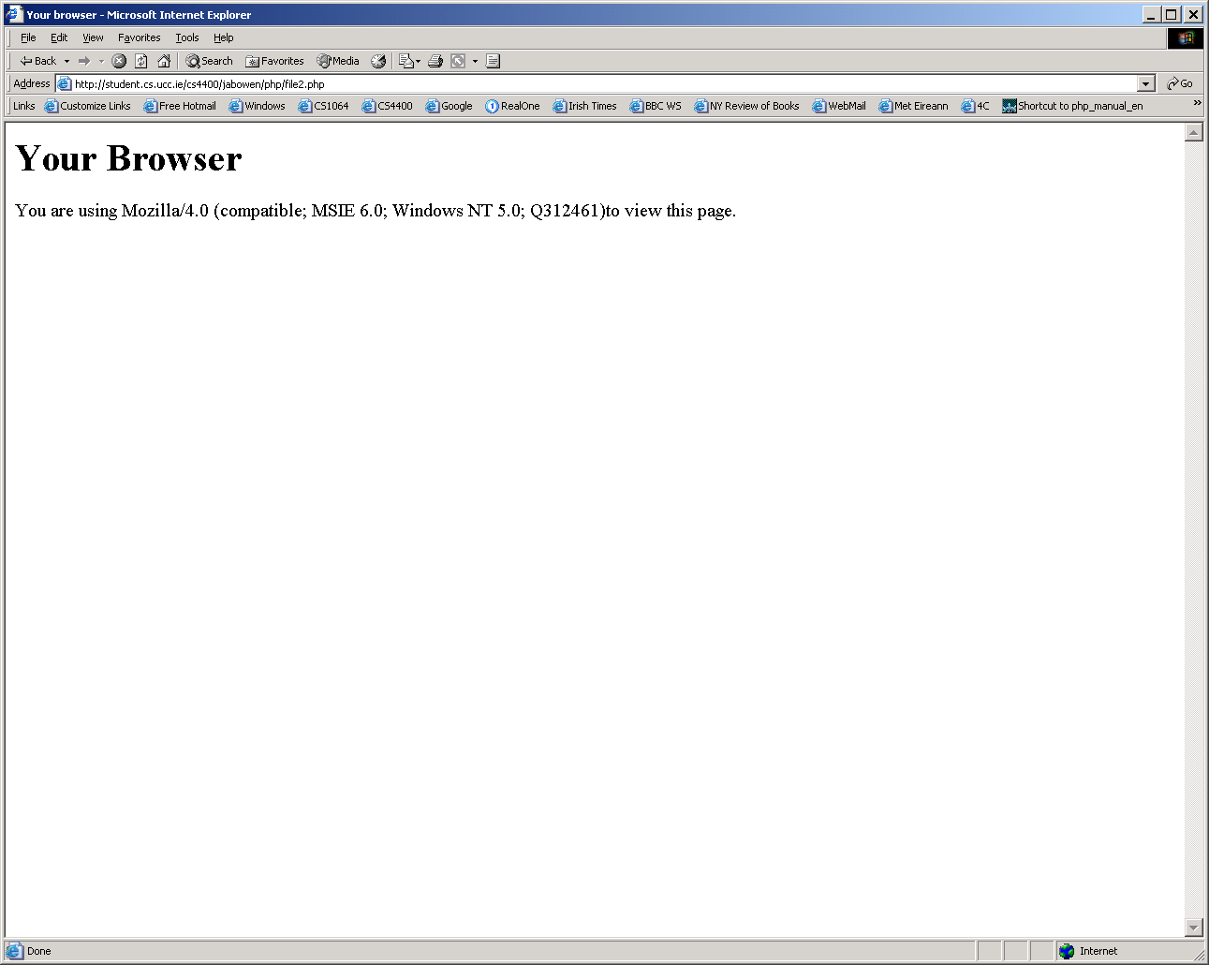

Slide 35
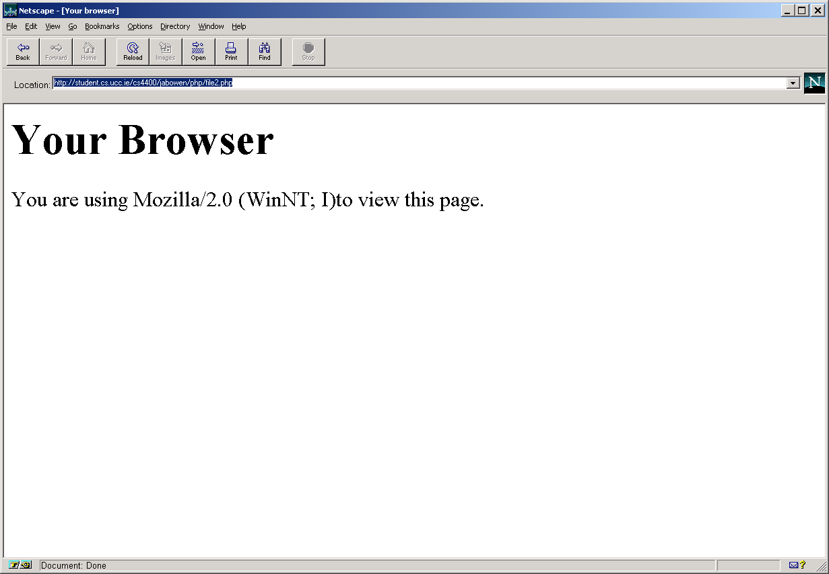

Slide 36
Global arrays
PHP creates 6 global arrays that contain EGPCS (environment, get, post, cookies and server) information
PHP also creates a variable called $_REQUEST that contains all the information in the 6 global arrays
PHP also creates a variable called $PHP_SELF that contains the name of the current script (relative to the doc root)

Slide 37
Global arrays
$_ENV – Contains the values of any environment variables, such as the browser version
  Eg: $_ENV[HTTP_USER_AGENT]
$_POST – The values of any variables posted to the request.
  Eg: $_POST[username]
$_GET – The values of any variables sent via the URL
  Eg: $_GET[username]

Slide 38
Changing Data Type
PHP will, in some circumstances, change the type of a datum
  For example, it will treat a string of digits as a number if it finds in an arithmetic expression
PHP also supports type casting
  <?php $myInteger = 12;
  $myFloat = 1.3;
  $result = $myFloat + (float) $myInteger;
  echo $result ?>

